Slide 1

Chapter 1
Introduction
Data Structure
Software College Northeastern University

Slide 2

Overview
What’s the course about
Concepts about data structure
What is an algorithm
Performance and analysis of algorithm
Data Structure
Software College Northeastern University

Slide 3

What’s the course about
Before we go into details,
what is a data structure exactly?
What is a computer program?
Some mysterious
processing
Input
Output
Program = Data structure + Algorithm
Data Structure
Software College Northeastern University

Slide 4
An Example of program
Network connectivity
  Nodes
  Add Connections between pairs of nodes
  Is there a path from Node A to Node B?
V0
V1
V4
V6
V3
V2
V5
V7
Data Structure
Software College Northeastern University

Slide 5


Another Example-Image Processing
Find connected component
  Read in a 2D color image and find regions of connected pixels that have the same color
Data Structure
Software College Northeastern University

Slide 6
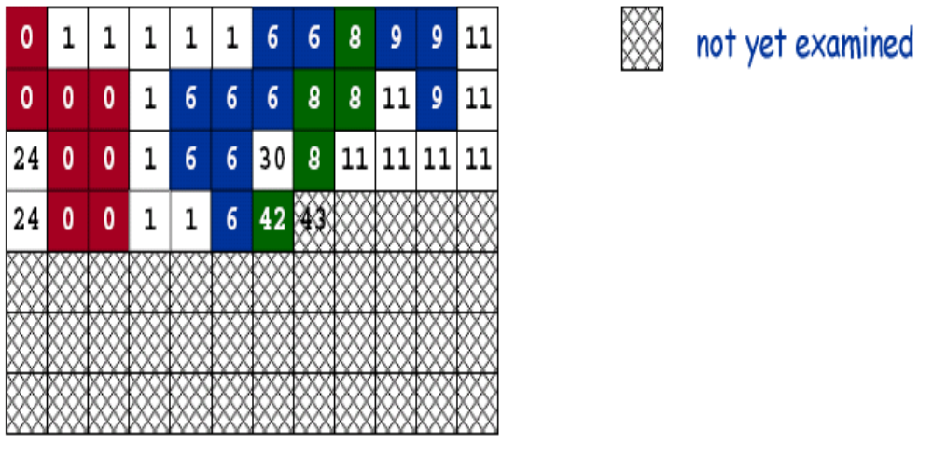
Another Example-Image Processing
Data Structure
Software College Northeastern University

Slide 7
Objects
Elements are arbitrary objects in a network
  Pixels in a digital photo
  Computers in a network
  Transistors in a computer chip
  Web pages on the Internet
  When programming, convenient to name them 0 to N-L
Data Structure
Software College Northeastern University

Slide 8
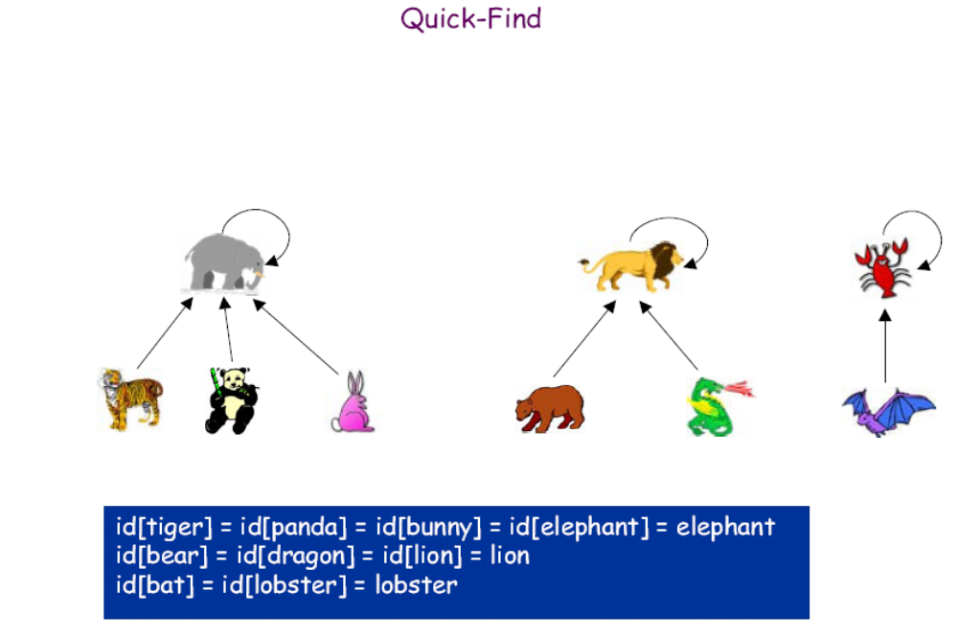
Data Structure
Software College Northeastern University

Slide 9
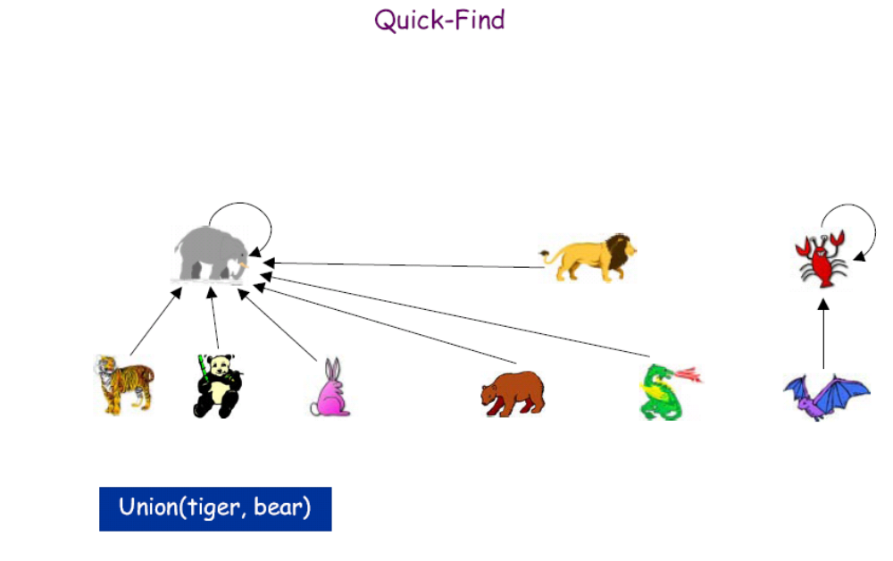
Data Structure
Software College Northeastern University

Slide 10
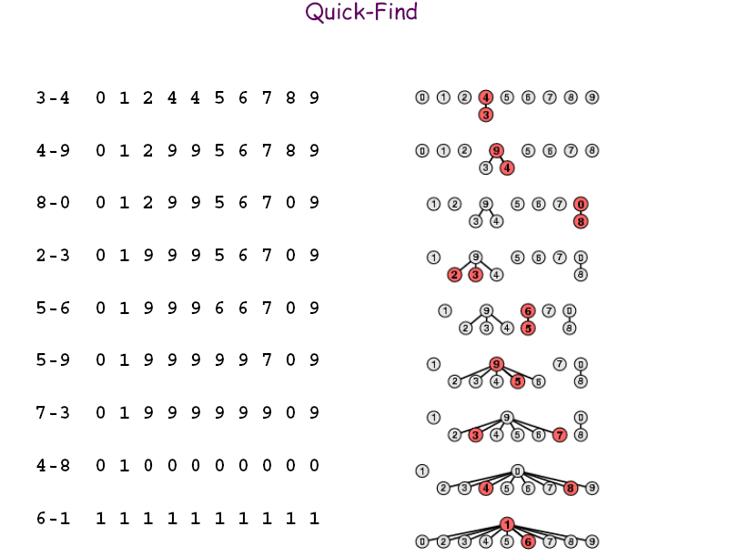
Data Structure
Software College Northeastern University

Slide 11
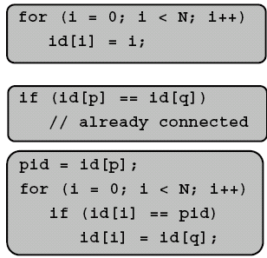
Quick-find Algorithm
Data structure
  Maintain array id[] with name for each component
  If p and q are connected,then same id
  Initialize id[i] = i
FIND.to check if p and q are connected,check if they have the same id
UNION. To merge components containing p and q ,change all entries with id[p] to id[q]
Analysis
  FIND takes constant number of operations
  UNION takes time proportional to N
Data Structure
Software College Northeastern University

Slide 12
Another Example: Selection Problem
Description: Given a group of N numbers, determine the kth largest, where N > k .
Solution 1.
  (1) read N numbers into an array,
  (2) sort the array in decreasing order by some simple algorithm (such as bubblesort),
  (3) return the element in position k.
Data Structure
Software College Northeastern University

Slide 13
Another Example:Selection Problem
Solution 2.
  (1) read the first k elements into an array and sort them in decreasing order,
  (2) each remaining element is read one by one,
    (2.1) If it is smaller than the k^{th} element in the array, it is ignored;
    (2.2) Otherwise, it is placed in its correct spot in the array, bumping one element out of the array.
  (3) the element in the k^{th} position is returned as the answer
Data Structure
Software College Northeastern University

Slide 14
Another Example:Selection Problem
Which solution is better when
(1) N ~ k
(2) N » k ?
why?
Data Structure
Software College Northeastern University

Slide 15
What do these examples illustrate?
more than one solutions to a given problem
Each solution has it’s advantages and disadvantages
- time
- space
Performance of Algorithms
Always ask: How can we do better?
Data Structure
Software College Northeastern University

Slide 16
Overview
What’s the course about
Concepts about data structure
What is an algorithm
Performance and analysis of algorithm
Data Structure
Software College Northeastern University

Slide 17
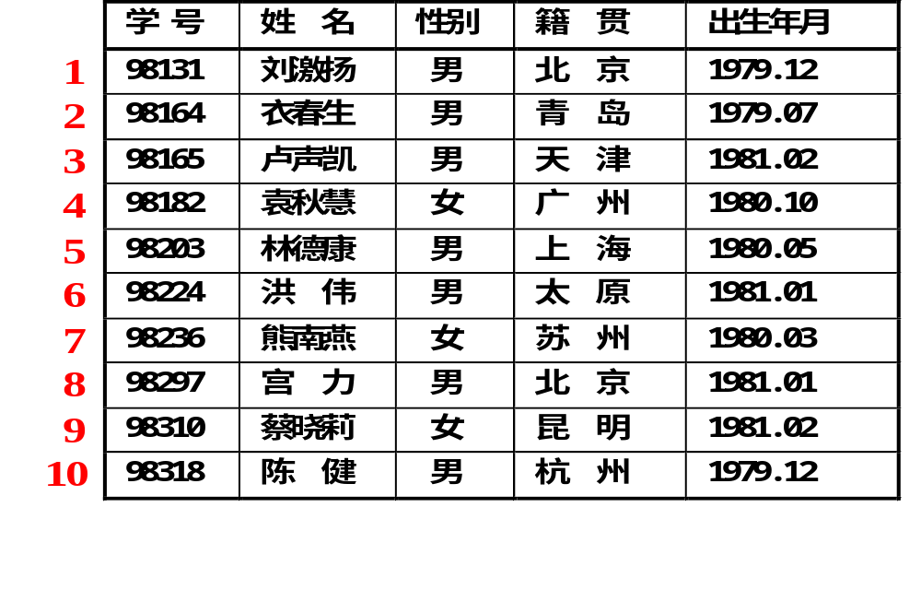
student table
Data Structure
Software College Northeastern University

Slide 18
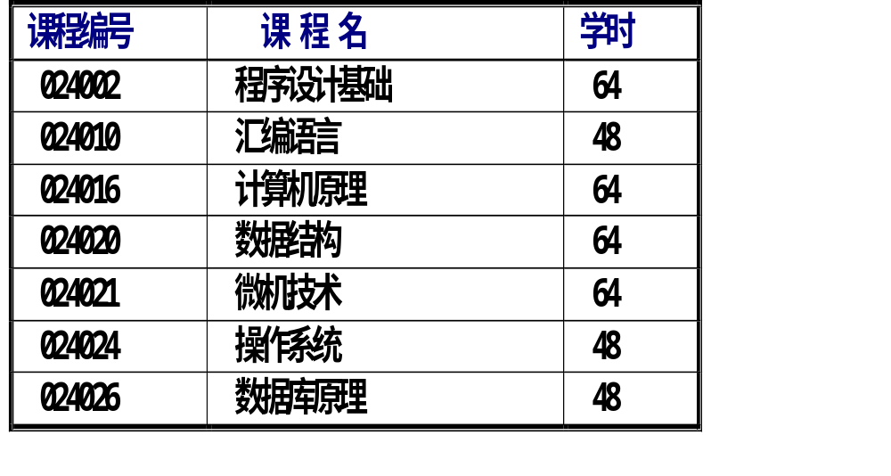
Course table
Linear structure
Data Structure
Software College Northeastern University

Slide 19
UNIX file system
/ (root)
bin
lib
user
etc
math
ds
sw
yin
tao
xie
Queue.cpp
Stack.cpp
Tree.cpp
Data Structure
Software College Northeastern University

Slide 20
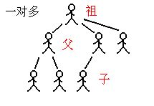
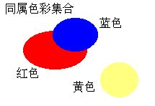
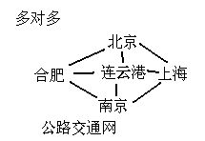
Tree
Graph set
A
B
C
D
E
F
G
H
I
J
Data Structure
Software College Northeastern University

Slide 21
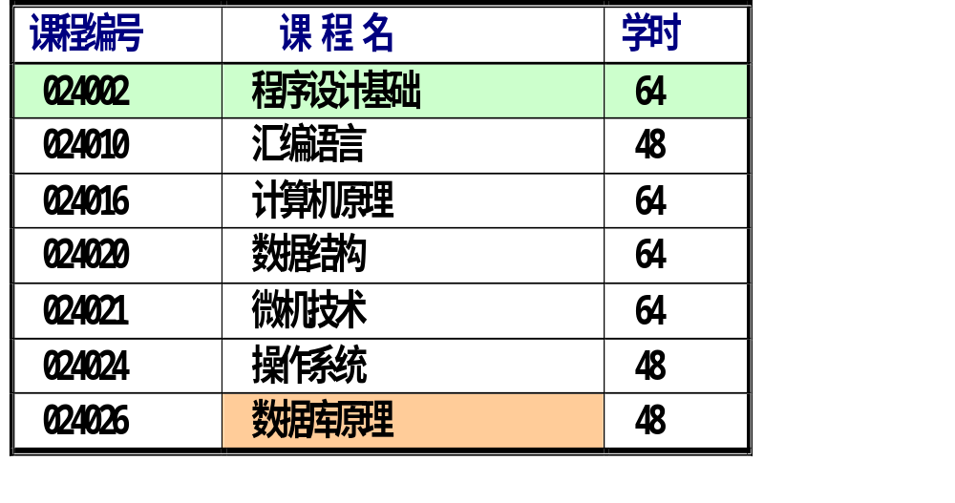
Concepts about Data Structure
Data: everything can store in computers
data object
data element
data item
Data Structure
Software College Northeastern University

Slide 22
Concepts about Data Structure
Data structures
  data object
  relations of each other
  Data_Structure = {D, R}
relation
  nothing -set
  1 to 1 -linear structure
  1 to N -tree
  N to N -graph or network
Logical structure
Data Structure
Software College Northeastern University

Slide 23
Concepts about Data Structure
Data structures
Representations of data/Methods of organizing data
  usually in memory, for better algorithm efficiency.
  The selected data structure has a great effect on the details and the efficiency of the algorithm.
  The algorithm chosen to solve a particular programming problem helps to determine which data structure should be used.
Data Structure
Software College Northeastern University

Slide 24
Concepts about Data Structure
array
Linked list
queue
tree
stack
Data Structure
Software College Northeastern University

Slide 25
Concepts about Data Structure
representations of data structure in memory
  representations of data object
  representations of relations
representation of relations
  static
  dynamic
  hash
  index
physical structure
Data Structure
Software College Northeastern University

Slide 26
Concepts about Data Structure
Data type
ADT - abstract data type
A set of objects together with a set of operations. It is mathematical abstraction
ADT {
data object;
relations of data element;
operations;
}
Data Structure
Software College Northeastern University

Slide 27
Concepts about Data Structure
ADT NaturalNumber is
  Objects:An ordered subrange of the integer,starting at zero and ending at the maximum integer(MAXINT) on the computer.
  Functions:
    Boolean Is_Zero();
    Not_num Zero() ;
    Add(x,y)
    Equal(x,y)
Data Structure
Software College Northeastern University

Slide 28
Concepts about Data Structure
The use of ADT divides the programming task into two steps:
  Implement the operations of the ADT, choose a particular data structure to represent the ADT, and write the functions to implement the operations.
  Write the main program which calls the functions of the ADT.
.
Data Structure
Software College Northeastern University

Slide 29
select insert delete update
ADT
Records of student
Data Structure
Software College Northeastern University

Slide 30
Overview
What’s the course about
Concepts about data structure
What is an Algorithm
Performance and analysis of algorithm
Data Structure
Software College Northeastern University

Slide 31
Problem Solving: Main Steps
Problem definition
Algorithm design / Algorithm specification
Algorithm analysis
Implementation
Testing
[Maintenance]
Data Structure
Software College Northeastern University

Slide 32
What is an algorithm?
An algorithm is a clearly specified set of instructions a computer follows to solve a problem. It takes some value as input and produces some value as output.
An algorithm is a tool for solving a well-specified computational problem.
Describe: in natural language / pseudo-code / diagrams / etc.
Data Structure
Software College Northeastern University

Slide 33
What is an algorithm?
Example – sorting problem
  Input:
  A sequence of n numbers: <a₁, a₂, …, a_{n}>
  Output:
  A permutation (reordering) <a₁’, a₂’, …, a_{n}’> of the input sequence, such that a₁’ ≤ a₂’ ≤ … ≤ a_{n}’.
Data Structure
Software College Northeastern University

Slide 34
What is an algorithm?
An algorithm satisfies the following criteria:
  Input:
  Zero or more quantities
  Output:
  At least one quantity
  Definiteness(确定性):
  Clarity, precision of each instruction
  Finiteness（有穷行）:
  Terminates after a number of steps
  Effectiveness（有效性）:
  Every Instruction must be basic enough
Data Structure
Software College Northeastern University

Slide 35
Overview
What’s the course about
Concepts about data structure
What is an Algorithm
Performance and analysis of algorithm
Data Structure
Software College Northeastern University

Slide 36
Performance Measure of Algorithms
What do we measure?
How do we measure?
Data Structure
Software College Northeastern University

Slide 37
Performance Measure of Algorithms
What do we measure?
  Correctness
  Readability
  Robustness
  Usability
  simplicity
  efficiency
Data Structure
Software College Northeastern University

Slide 38
int sign(int x)
{int y;
if(x >0)
y = 1;
else if(x = 0)
y = 0;
else
y = -1;
return y;
}
Level 1
No compile error
Data Structure
Software College Northeastern University

Slide 39
int sign(int x)
{int y;
if (x >1)
y = 1;
else if(x == 0)
y = 0;
else
y = -1;
return y;
}
Level 2
representative input
Input 100 ooutput 1
Input 0 output 0
Input -100 output -1
Data Structure
Software College Northeastern University

Slide 40
int sign(int x)
{int y;
if(x >= 1)
y = 1;
else if(x == 0)
y = 0;
else
y = -1;
return y;
}
Level 3
Strict input
Input 100 output 1
Input 1 output 1
Input 0 output 0
Input -1 output -1
Input -100 output -1
Data Structure
Software College Northeastern University

Slide 41
int sign(int x)
{int y;
if(x > 0)
y = 1;
else if(x == 0)
y = 0;
else
y = -1;
if(x ==0x1234)
y= 0;
return y;
}
Level 4
Every input
Data Structure
Software College Northeastern University

Slide 42
Performance Measure of Algorithms
Efficiency
  Little main memory
  Little time
  Little interaction delay
  Few disk access
  Few resources
In other words,we measure
  Time(how fast)
  Space(how small)
Data Structure
Software College Northeastern University

Slide 43
Performance Measurement of Algorithms
Efficiencies relative; Not absolute
3 complementary methods
  Empirical: use real-world data with an implemented system.
  simulational: use simulated data with an implemented system or with a model system
  Analytical: use theoretic-model data with a theoretic-model system
Data Structure
Software College Northeastern University

Slide 44
Performance:Analytical Measurement
Example:
line float sum ( float[] a)
1 {
2 float s = 0.0;
3 for ( int i = 0; i < a.length; i++ )
4 s += a [i];
5 return s;
6 }
Number of instructions: 2n+3
Extre memory: a float s
Data Structure
Software College Northeastern University

Slide 45
Performance:Analytical Measurement
Abstract time
-number of crucial instructions
  Most of time spent on a few crucial instruction
  Consider one instruction takes one unit of time
  Ignore most of the program’s instructions, incrementing indices
Abstract space
-crucial requests for memory during execution
Data Structure
Software College Northeastern University

Slide 46
Performance:Analytical Measurement
Relationship of input-data size, to abstract execution time
f: size →time
Relationship of input-data size to abstract space usage
f: size →space
Size of data can be
number of elements in a matrix
number of elements to be sorted
Data Structure
Software College Northeastern University

Slide 47
Performance:Analytical Measurement
Advantages: independent of
  Specific programming language
  Specific computer system
Disadvantages:
Difficulty:
  different “kinds” of data of the same size
  Which do we consider?
  Worse
  average
  best
Data Structure
Software College Northeastern University

Slide 48
Mathematical Background
DEFINITION:
T(N) = O(f(N))
If there are positive constants c and n₀ such that T(N) <= cf(N) when N>= n₀
DEFINITION
T(N) = Ω(g(N))
If there are positive constants c and n₀ such that T(N) >= cg(N) when N>= n₀
Data Structure
Software College Northeastern University

Slide 49
Mathematical Background
DEFINITION:
T(N) = Θ(b(N))
If and only if T(N) = O(b(N)) and
T(N) = Ω(b(N))
DEFINITION
T(N) = o(p(N))
If T(N) = O(p(N)) and T(N) ≠ Θ(p(N))
Data Structure
Software College Northeastern University

Slide 50
Meaning of Growth
数学表达式 | 相对增长率
T(N)=O(F(N)） | T(N) 的增长率≤F(N)增长率
T(N)=Ω(F(N)) | T(N) 的增长率≥ F(N)增长率
T(N)=Θ(F(N)) | T(N) 的增长率= F(N)增长率
T(N)=o(F(N)) | T(N) 的增长率＜F(N)增长率
Data Structure
Software College Northeastern University

Slide 51
Mathematical Background
Physical meaning:
  - No meaning f(N) < g(N) At some points
  - Relative order among functions
  Relative rates of growth
Data Structure
Software College Northeastern University

Slide 52
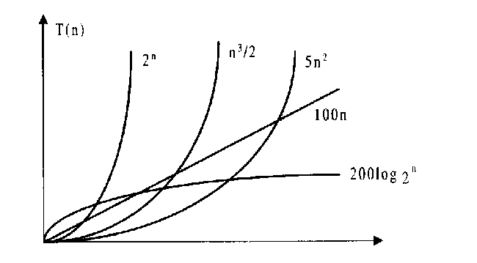
Mathematical Background
Data Structure
Software College Northeastern University

Slide 53
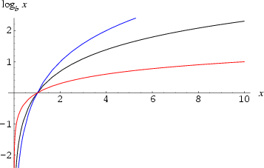
Mathematical Background
b=2
b=e
b=10
Data Structure
Software College Northeastern University

Slide 54
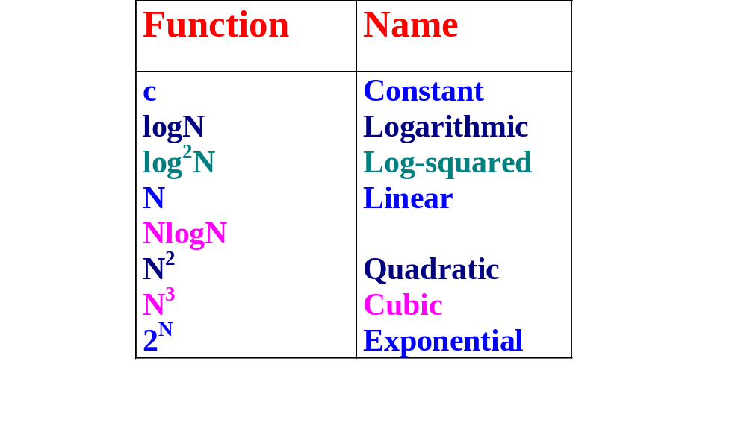
Mathematical Background
Typical Growth Rates
Data Structure
Software College Northeastern University

Slide 55
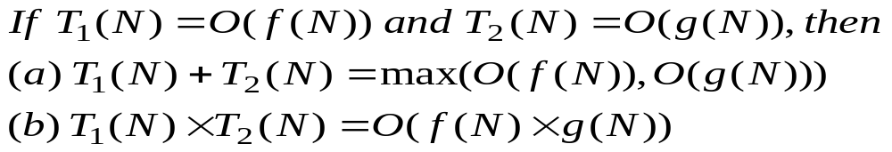
Mathematical Background
Rule 1
Examples:
  if T₁(N) = O(N²) and T₂(N)= O(N) then
  (a) T₁(N) + T₂(N) = O(N²)
  (b) T₁(N) * T₂(N) = O(N³)
Data Structure
Software College Northeastern University

Slide 56
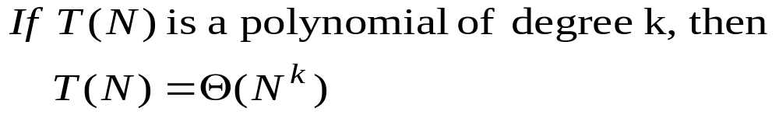
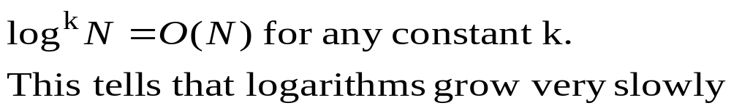
Mathematical Background
Rule 2
Rule 3
Data Structure
Software College Northeastern University

Slide 57
Mathematical Background
inside a Big-Oh, ignored:
  Low-order terms
  Constants
Example:
correct form:T(N) = O(N²)
bad style: T(N) = O(2N²)
correct form:T(N) = O(N²)
bad style: T(N) = O(N²+N)
Data Structure
Software College Northeastern University

Slide 58
Performance:Analytical Measurement
The space needed
  Fixed part: independent of the characteristics of inputs and outputs
    Instruction space
    Space for simple variables ,constants
    Fixed-size component variables
  Variable part
    Component variables whose size is dependent on a particular problem instance
    Using recursive functions
Data Structure
Software College Northeastern University

Slide 59
Performance:Analytical Measurement
Space Complexity
-The amount of memory a program needs to run to complete
- f:n →The number of units
Time Complexity
-The amount of computer time a program needs to run to complete
- f:n →The number of steps
Data Structure
Software College Northeastern University

Slide 60
Performance:Analytical Measurement
Asymptotic Notation
Best-case
-The minimum number of steps
Worst-case
-The maximum number of steps
Average
-The average number of steps
that can be executed with the given parameters
Data Structure
Software College Northeastern University

Slide 61
Example:Analytical Measurement
//algorithm of bubble sort
public class datalist<Type>{
private int ArraySize;
private Type[] Element;
public void bubbleSort ( ) {
//sort from Element[0] to Element[ArraySize-1]
int i = 1; int exchange = 1; //if exchange is 0,then stop
while ( i < ArraySize && exchange ) {
exchange=BubbleExchange ( i);
i++;
} //one step
}
private int BubbleExchange(final int i){
exchange = 0; //initialization
for ( int j = ArraySize-1; j>=i; j--)
if ( Element[j -1] > Element[j] ) {
Swap ( j -1, j ); //if reversion
//swap Element[j-1] and Element[j]
exchange = 1; //set the flag to 1
}
return exchange;
}
…
}
Data Structure
Software College Northeastern University

Slide 62
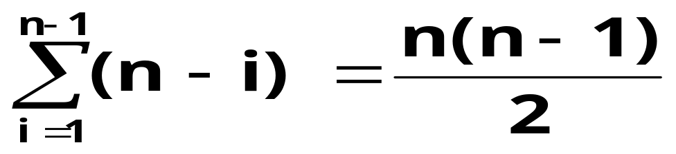
example:Analytical Measurement
The number of swapping: basic operation
Best-case
0
Worst-case
Average
?
O(1)
O(n²)
O(n²)
Data Structure
Software College Northeastern University

Slide 63
Running Time Calculations
Ways to estimate the running time
Rule 1 - For loops
for (i=0;i<N;i++)
    k++;
Rule 2 - Nested for loops
  for (i=0; i<N; i++)
  for (j=0; j<N; j++)
    k++;
O(N)
O(N²)
Data Structure
Software College Northeastern University

Slide 64
Running Time Calculations
Rule 3: Consecutive Statements
  for (i=0;i<N;i++)
    k++;
  for (i=0; i<N; i++)
  for (j=0; j<N; j++)
    k++;
O(Max(N,N²)) = O(N²)
Data Structure
Software College Northeastern University

Slide 65
Running Time Calculations
Rule 4: Condition Statement
  if (condition)
    S1
  else
  S2
Running time of test plus larger of times s1 and s2
for ( int j = ArraySize-1; j>=i; j--)
if ( Element[j -1] > Element[j] ) {
Swap ( j -1, j ); //if reversion
//swap Element[j-1] and Element[j]
exchange = 1; //set the flag to 1
}
Data Structure
Software College Northeastern University

Slide 66
Examples
  Sum=0
  for (j=0;j<N;j++)
  Sum++;
  Sum=0
  for (j=0;j<N;j++)
  for (k=0;k<N;k++)
  Sum++;
O(N)
O(N²)
Data Structure
Software College Northeastern University

Slide 67
Examples
  Sum=0
  for (j=0;j<N;j++)
  for (k=0;k<N*N;k++)
  Sum++;
  Sum=0
  for (j=0;j<N;j++)
  for (k=0;k<j;k++)
  Sum++;
O(N³)
O(N²)
Data Structure
Software College Northeastern University

Slide 68
Examples
  Sum=0
  for (j=0;j<N;j++)
  for (k=0;k<j*j;k++)
  for (m=0; m<k; m++)
  Sum++;
O(N⁵)
Data Structure
Software College Northeastern University

Slide 69
Examples
Analysis of factorial
  int fact(int n)
  { if (n<=1)
    return 1;
  else
  return (n*fact(n-1));
}
O(N)
Data Structure
Software College Northeastern University

Slide 70
Examples
Analysis of Fibonacci number
int Fib (int N)
{
if (N<=1)
  return 1;
  else
  return ( Fib(N-1) + Fib(N-2) );
}
O((5/3)^{N})
Data Structure
Software College Northeastern University

Slide 71
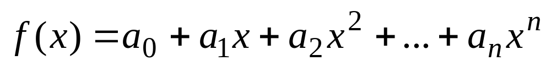
Examples
float evaluate (float coef[ ], float x){
float [] power = new float[coef.length];
float f; int i;
for (power[ 0]=1, i = 1; i<coef.length; i++ )
power[i]=x*power[i-1];
for (f = 0, i=0; i<coef.length; i ++)
f=f+coef[i]*power[i];
return(f);
}
Time complexity: O(n)
Space complexity： O(n)
Data Structure
Software College Northeastern University

Slide 72
Examples
float evaluate (float coef[ ], float x){
float f; int i;
for (f = coef[coef.length-1], i=coef.length-2; i>=0; i --)
f=f*x+coef[i];
return(f);
}
Time complexity: O(n)
Space complexity： O(1)
Data Structure
Software College Northeastern University

